Slide 1
MSAS Tutorial Sequence -Module Three-
WRITTEN BY ADVAY MUCHOOR

Slide 2

LET’S GET READY TO WORK

Slide 3
Goals of Today
Finish up the basics of Python
Booleans
If/Else
Lists
Loops
Dictionaries
Understand Pandas
Getting some I/O with dataframes
Reading from Excel
Webscraping
Basic dataframe operations

Slide 4
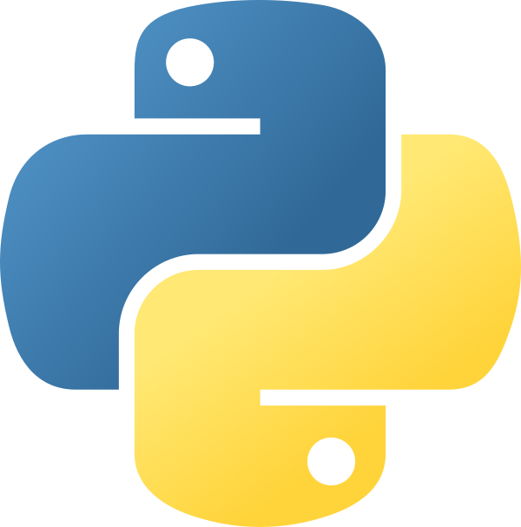
More Python

Slide 5
Booleans
Booleans represent a “True” or “False” variable (can only hold these two values)
Often used for comparison purposes
Declared just like any other variable
is_starter = True
temp = False
Can also be used in inequalities and expressions
More on this in a bit

Slide 6
Operators
The only three operators you should need to know for python are the following:
“and”
“or”
“not”
All three operators are used in their plaintext form (no need for “&&” or “||” or “!”)
Truth tables:
A | Operand | B | Result
True | and | True | True
True | and | False | False
False | and | False | False
True | or | True | True
True | or | False | True
False | or | False | False

Slide 7
Conditions
Recap: Python supports the usual logical conditions from mathematics:
Equals: a == b
Not Equals: a != b
Less than: a < b
Less than or equal to: a <= b
Greater than: a > b
Greater than or equal to: a >= b
“If” statements allow us to check “if” a condition is true or false
If the statement evaluates to True, we will go into to that “if” block and run what is inside it

Slide 8
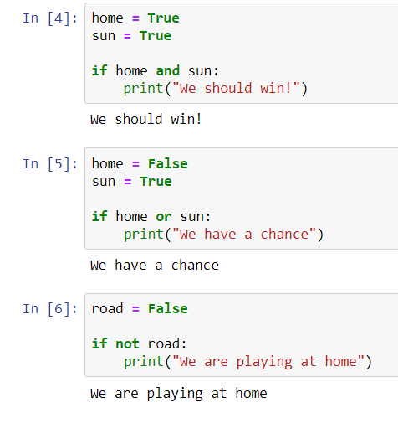
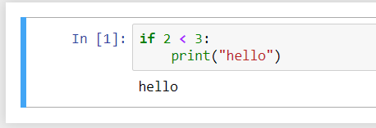
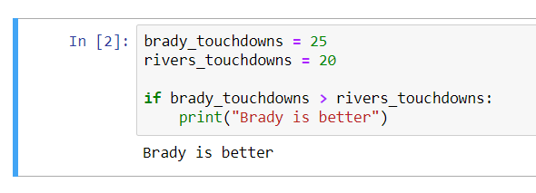

Slide 9
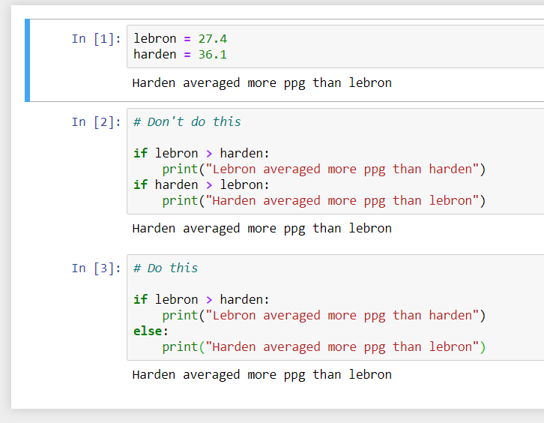
Else statements
Must be directly paired with an “if” statement
The “else” keyword catches anything that isn’t caught by the if statement
If a condition is not hit, the else statement will run. Otherwise it will not.
Yes, an if/else clause is literally an if/else clause

Slide 10
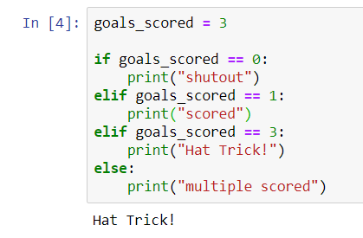
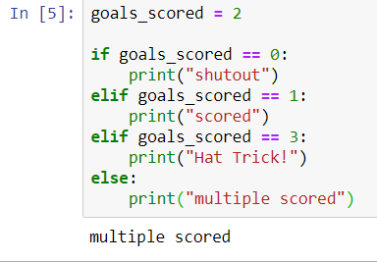
If/Elif/Else
“Elif” clauses allow for multiple if statements to be checked (short for “else if”)
First, the “if” statement is checked
Next, each “elif” clause will be checked until one is hit
Finally, if none of the “elif” clauses are hit, the “else” clause is run

Slide 11
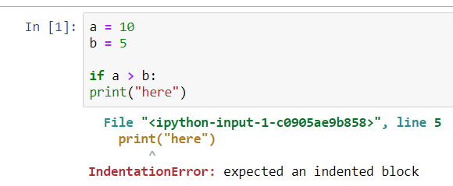
INDENTATION MATTERS

Slide 12
Lists
Lists are a collection of items that is ordered and can be changed
Lists are indicated by square brackets: []
We can declare a list in three different ways:
An empty list 🡪 my_list = []
Fill it with elements 🡪 my_list_2 = [“Ravens”, “Saints”, “Patriots”]
This is a list of strings, but we can have a list of any datatype
You can mix and match your datatypes within the list, but this is considered bad practice
Set it equal to another list 🡪 my_list_3 = my_list_2
You can get the number of elements in the list by calling the “len” function
my_list = [1, 2, 3, 4]
print(len(my_list)) 🡪 4
Clear the list by calling the “clear function”
my_list.clear()
print(my_list) 🡪 ???

Slide 13
Accessing elements of a list
You can access list items by referring to the index number
Lists in Python are “0-index based”
Example:
stats = [“pts”, “reb”, “ast”]
print(stats[0]) “pts”
print(stats[1]) “reb”
Print(stats[2]) “ast”
Print(stats[3]) Error! Why?
Print(stats[-1]) ???
You can access a range of indexes by specifying where to start and where to end (called slicing)
Use the following format: list[start:end]
qbs = [“Brady”, “Rivers”, “Jackson”, “Stafford”, “Cousins”]
slice = qbs[2:4]
print(slice) [“Jackson”, “Stafford”, “Cousins”]

Slide 14
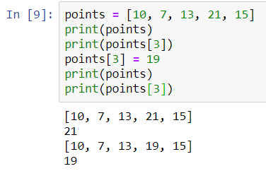
Updating a list element
To update a list element, simply index into the list and reassign its value

Slide 15
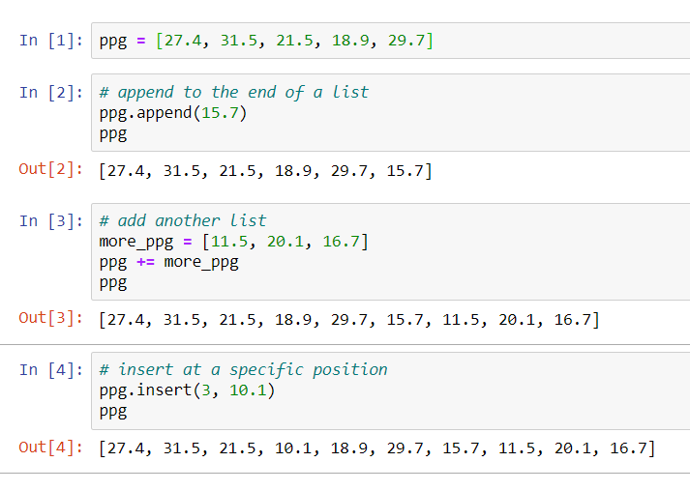
Adding to a list

Slide 16

Range-based for loops (one way to loop)
A “for” loop is used for iterating over a sequence
For our purposes, this will usually be a list
We will only cover range based loops in this module
This is a brief sneak peak… for more information
Other loops aren’t used traditionally in data science unless you are exploring a niche
Don’t need to index into array
Use cases:
When you want to view every element of a list in sequential order
Save time from indexing into specific elements
Syntax:

Slide 17
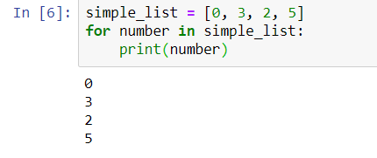
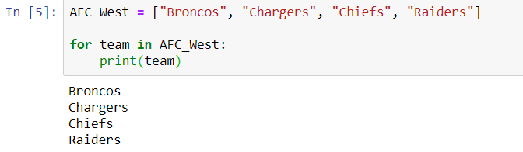
Basic loop examples

Slide 18
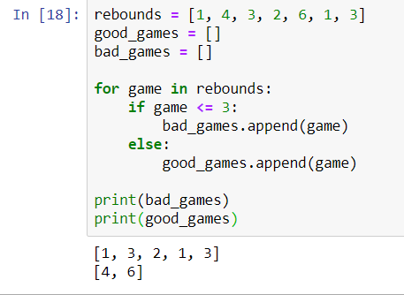
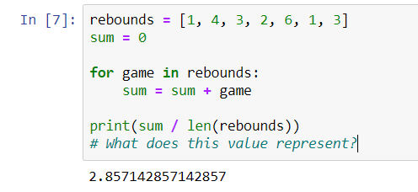
Basic loop applications

Slide 19
Dictionaries
Arguably one of the most important data structures in all of computer science
A dictionary is a collection of items which is unordered and indexed.
In Python, dictionaries are written with curly brackets and have keys and values
Keys are how you access values within the data structure
In a list, you index into the elements by numerical index
In a dictionary, you index into values with a key!
Every key is unique, but keys can have the same value
Why are dictionaries useful?

Slide 20
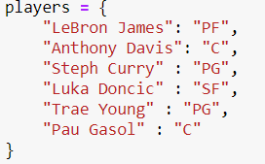
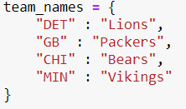
Example Dictionaries

Slide 21
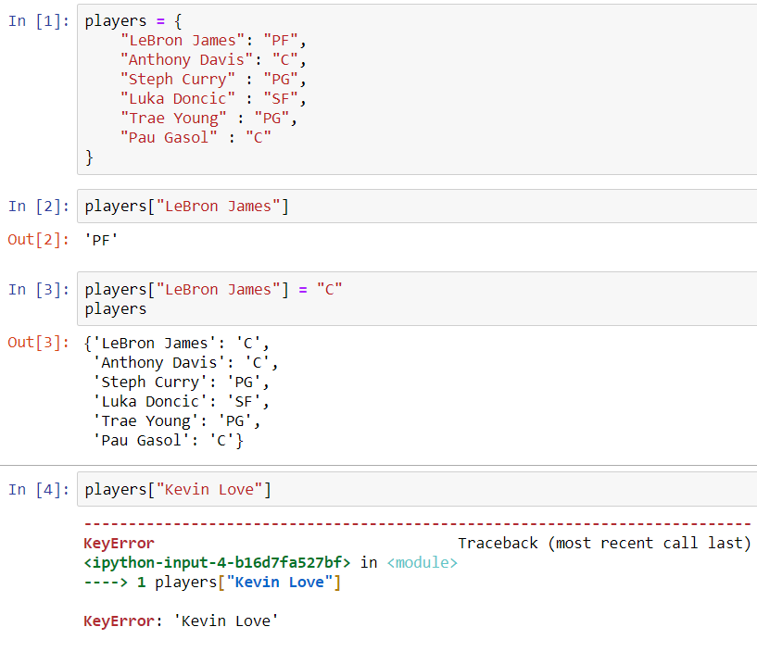
Accessing elements in a dictionary

Slide 22
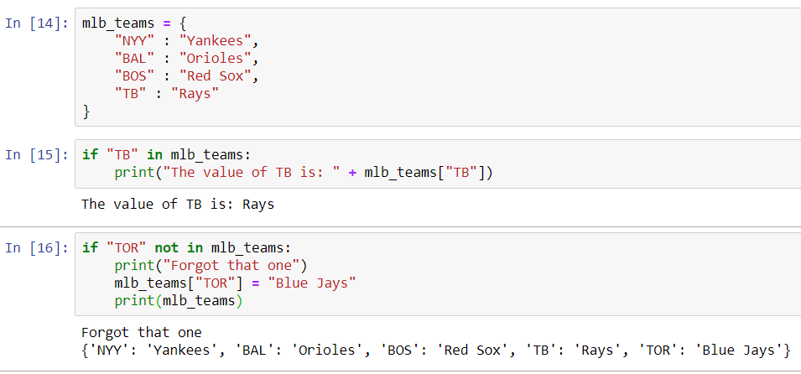
Checking if an element is in a dictionary (try it on lists too!)

Slide 23
Questions about anything we talked about?
IF NOT, TAKE A COUPLE MINUTES TO WORK WITH THESE CONCEPTS

Slide 24
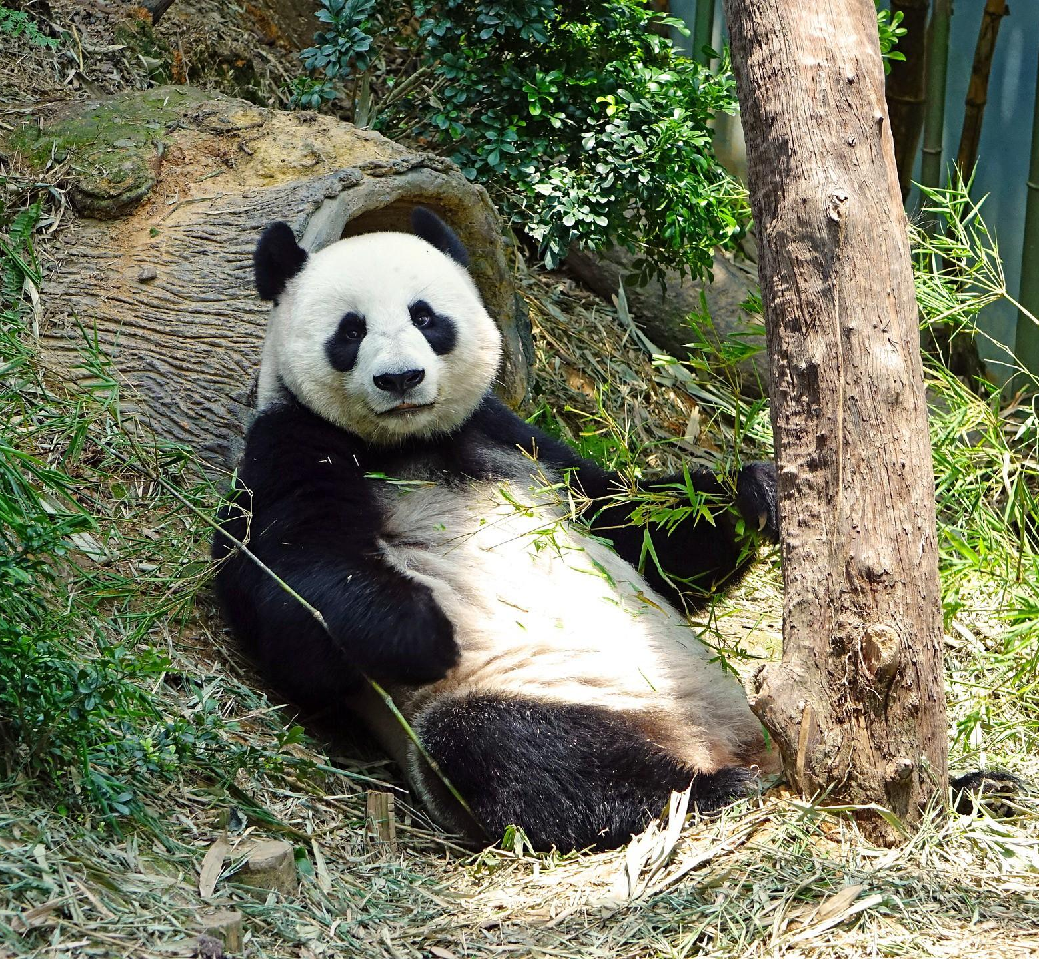


Pandas Welcome to REAL Data Science

Slide 25
Libraries in Python
A python library is a collection of functions that allows you to perform specific actions with your code
More often than not, a library is designed for a specific feature. There are libraries to…
Move and modify files on your computer
Create graphical interfaces for your code
Webscrape (more on that in the next module)
Perform data science operations ☺
And much more!
Libraries can be imported with the following syntax:
import library (imports entire library)
import library as lib (imports entire library as an alias, usually used to not clutter up code)
from library, import function a, b (imports functions a and b from the library, saves memory)
To access functions of your imported library, you will need to use the dot operator
We will see this throughout the module sequence

Slide 26
What is Pandas?
From their documentation:
“pandas is an open source, BSD-licensed library providing high-performance, easy-to-use data structures and data analysis tools for the Python programming language.”
Very powerful data science library
The basis of the rest of this module, as well as the next three!
Import pandas at the top of your jupyter notebok
import pandas as pd

Slide 27
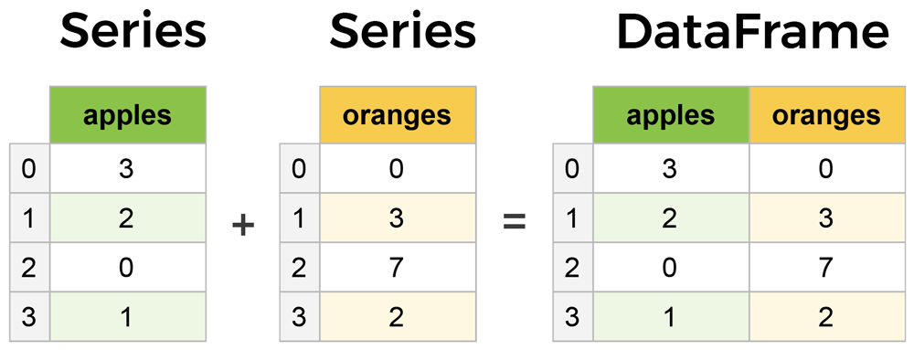
Series vs DataFrames
The primary two components of pandas are Series and DataFrames
Series is a column in your table, and a DataFrame is a multidimensional table comprised of a collection of Series

Slide 28
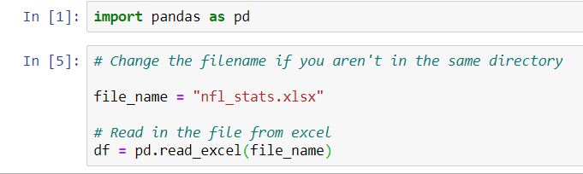
Reading in Files
import url lib.request
urllib.request.urlretrieve('https://github.com/gfolbe318/MSAS_tutorials/raw/master/3_Module/nfl_stats.xlsx', 'nfl_stats.xlsx’)

Slide 29
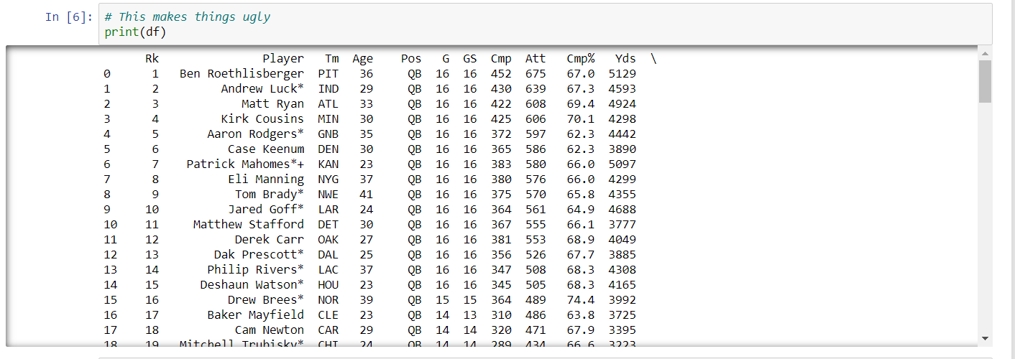
Printing a DataFrame

Slide 30
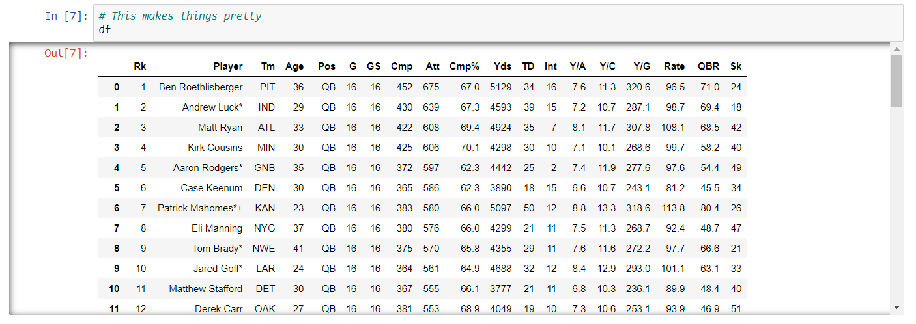
Displaying a DataFrame

Slide 31
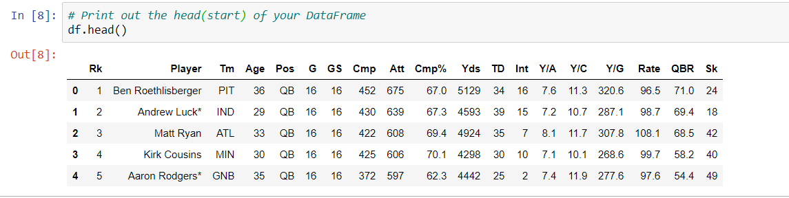
Displaying the head of a DataFrame

Slide 32
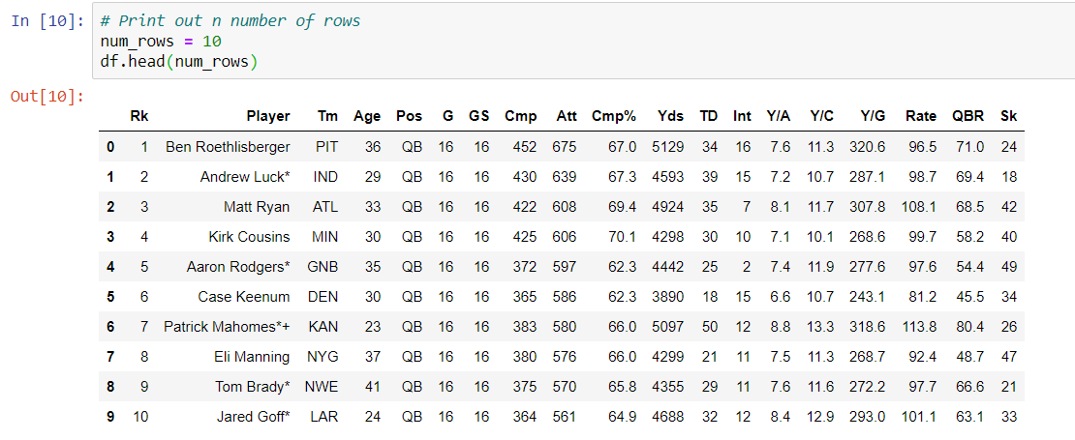
Display a Specific Number of Rows

Slide 33
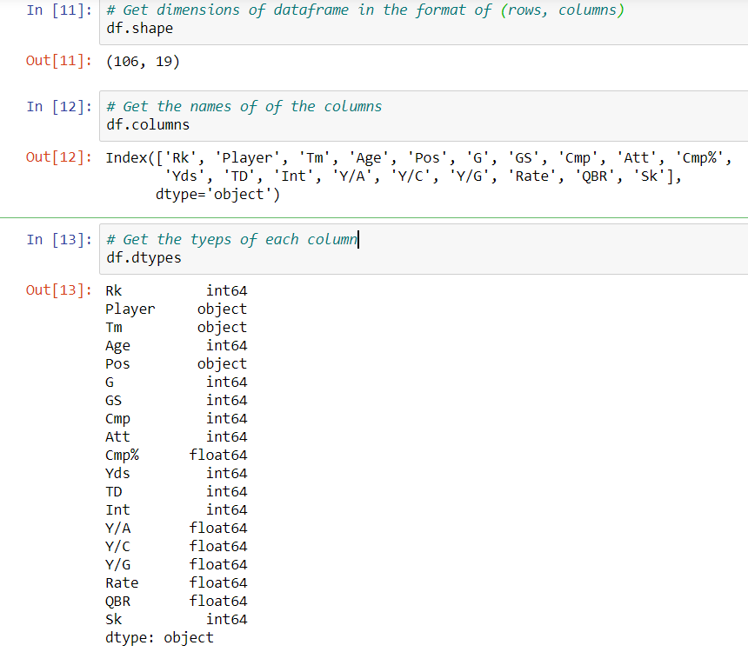
Get Information about the DataFrame

Slide 34
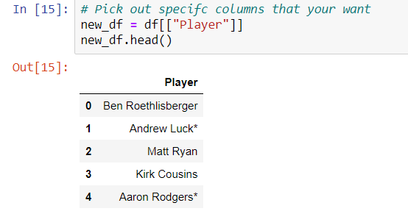
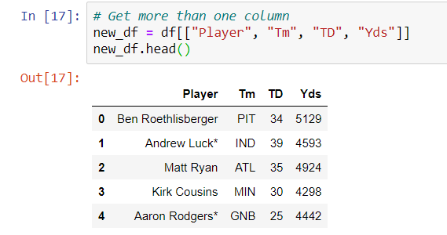
Extract Certain Columns

Slide 35

Write to Excel

Slide 36
Any Questions?

